Slide 1

IT5002
Computer Systems and Applications
Lecture 11
Introduction to Operating Systems
colintan@nus.edu.sg

Slide 2
Learning Objectives
By the end of this lecture you should be able to:
  Describe the onion model.
  Understand the interaction between layers of the onion model.
  Describe the options for programming I/O.
  Give an overview of the key issues in OS design.

Slide 3
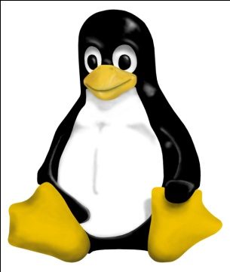
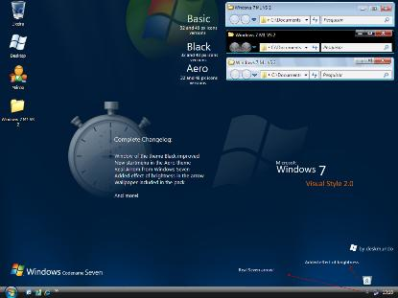
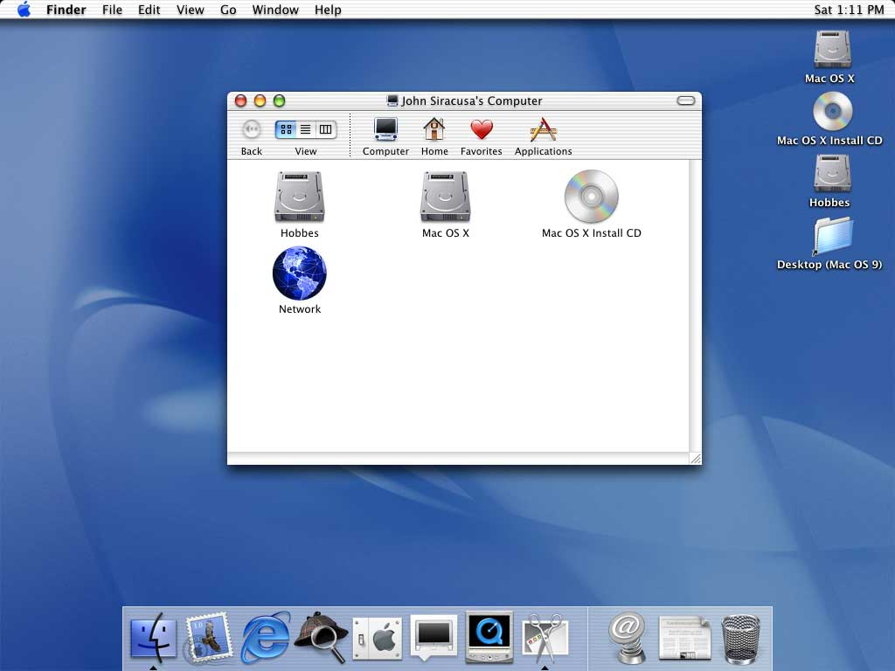
What are Operating Systems?
An “operating system” is a suite (i.e. a collection) of specialized software that:
  Gives you access to the hardware devices like disk drives, printers, keyboards and monitors.
  Controls and allocate system resources like memory and processor time.
  Gives you the tools to customize your and tune your system.
Examples include LINUX, OS X (a variant of UNIX), Windows 8.

Slide 4
What Are Operating Systems?
Usually consists of several parts:
  Bootloader – First program run by the system on start-up. Loads remainder of the OS kernel.
    On Wintel systems this is found in the Master Boot Record (MBR) on the hard disk.
  Kernel – The part of the OS that runs almost continuously.
    The bulk of this course is about how the kernel works.
  System Programs – Programs provided by the OS to allow:
    Access to programs.
    Configuration of the OS.
    System maintenance, etc.

Slide 5
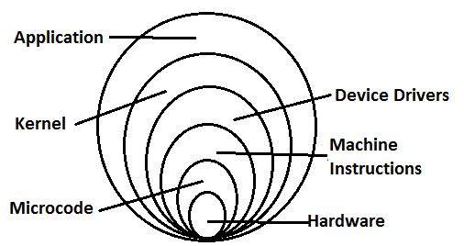
Basic Terminology:
The Onion Model.

Slide 6
How an OS Works
Bootstrapping

Slide 7
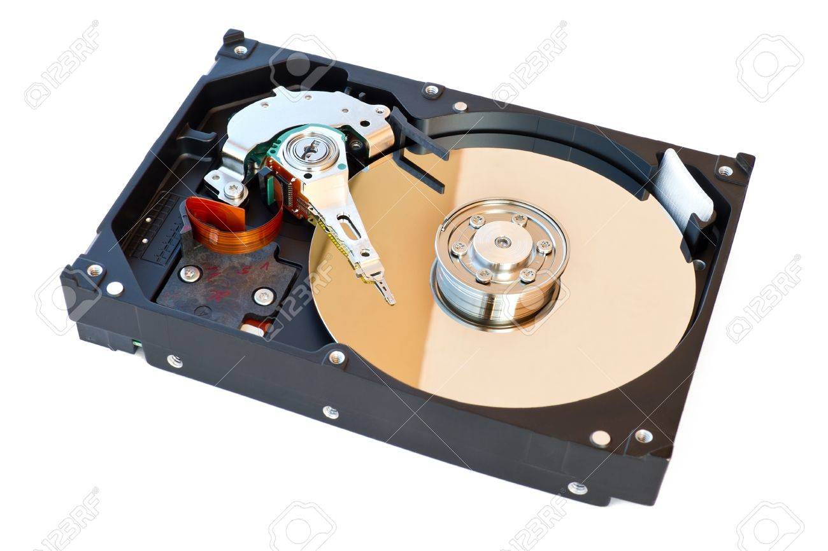
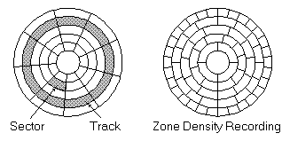
How an OS Works
Bootstrapping
The OS is not present in memory when a system is “cold started”.
  When a system is first started up, memory is completely empty.
  How do we get an operating system into memory?
We start first with a bootloader.
  Tiny program in the first (few) sector(s) of the hard-disk.
    The first sector is generally called the “boot sector” or “master boot record” for this reason.
  Job is to load up the main part of the operating system and start it up.

Slide 8
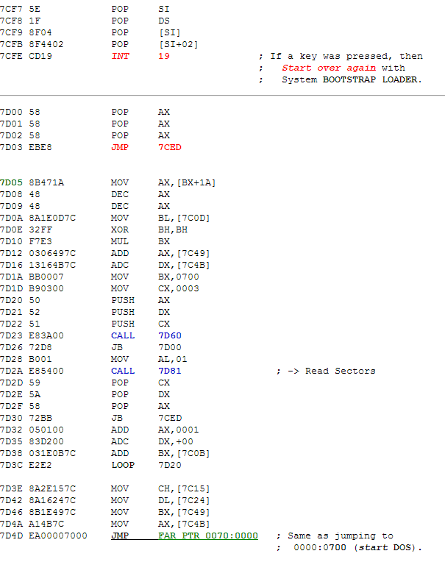

Slide 9
How an OS Works
Process Management

Slide 10
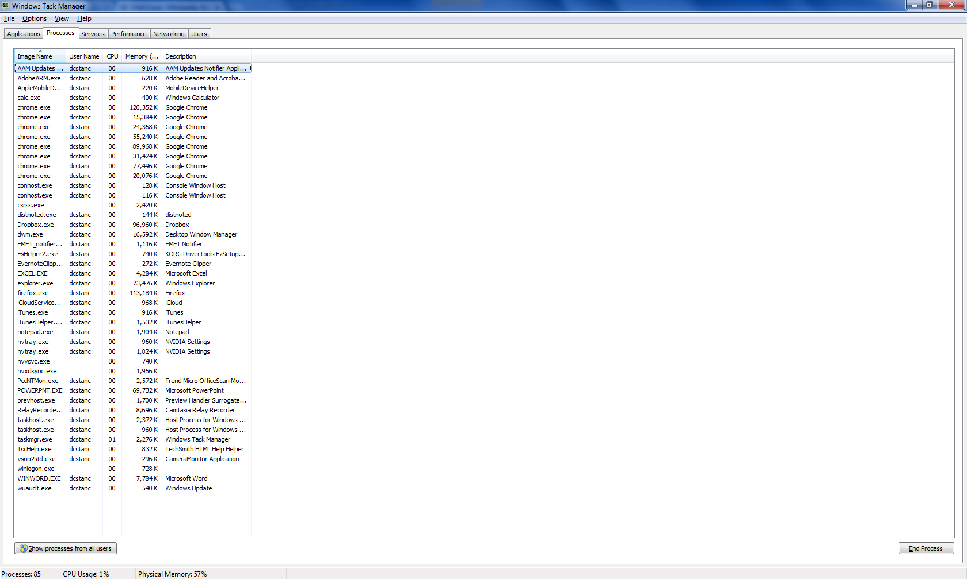
How an OS Works
Context Switching
A shortage of cores.
  A typical system today has two to four “cores”.
    CPU units that can execute processes.
  We have much more than 4 processes to run.

Slide 11
How an OS Works
Context Switching
To manage, we share a core very quickly between multiple processes.
Key points:
  Entire sharing must be transparent.
  Processes can be suspended and resumed arbitrarily.
    I.e. it is not usually possible to build in this “sharing” into a process.
Solution:
  Save the “context” of the process to be suspended.
  Restore the “context” of the process to be (re)started.

Slide 12
How an OS Works
Scheduling
So we see that a single system may have multiple processing units (“cores”), but there will generally be many more processes than cores.
  We settled this problem with context switching.
BUT how do we choose which process to run if several want to run?
  Should interactive processes be chosen over background processes?
    Obviously not all the time because background processes will starve
  Are some processes more important than others?
  This is the issue of scheduling.

Slide 13
How an OS Works
Organizing Data On Your Computer

Slide 14
How an OS Works
File Systems
An OS must support persistent storage.
  This is storage whose contents do not disappear when the system is turned off.
  E.g.:
    Executable program files.
    Database files.
    …
The primary way to do this is through a “file system” on persistent storage devices like hard disks.
  A set of data structures on disk and within the OS kernel memory to organize persistent data.

Slide 15
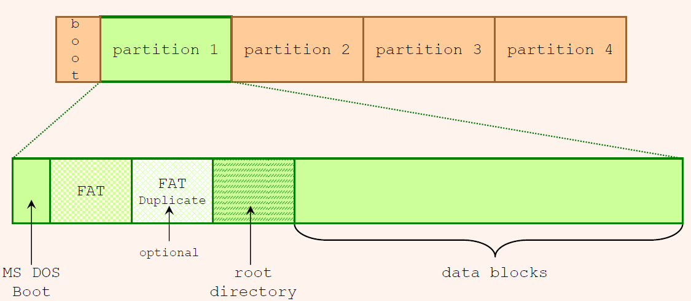
How an OS Works
File Systems

Slide 16
How an OS Works
Interfacing to Hardware

Slide 17
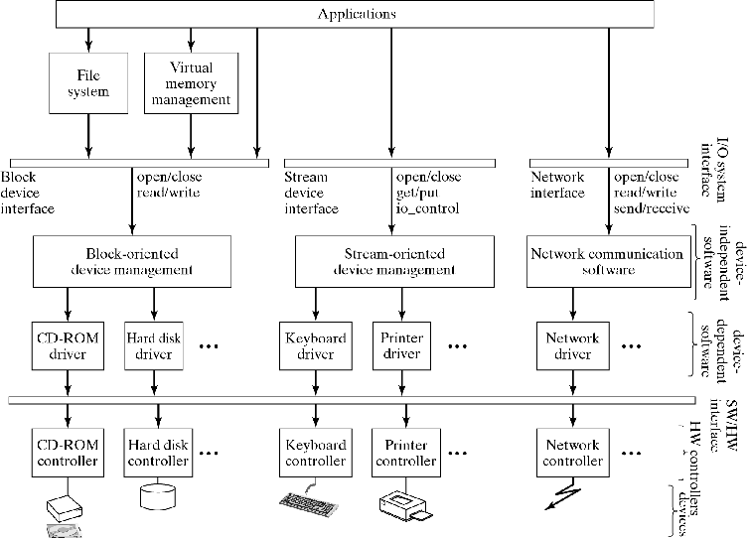
Operating Systems

Slide 18
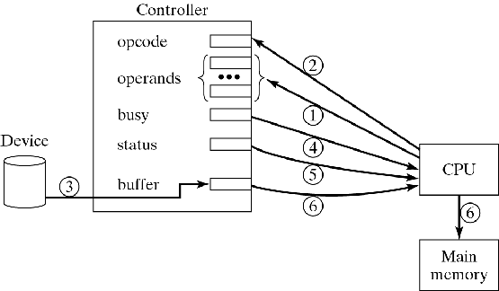
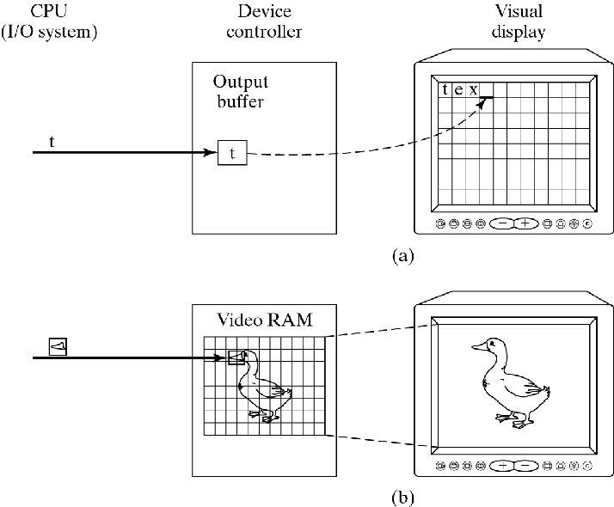
Operating Systems

Slide 19
How an OS Works
Managing Memory

Slide 20
How an OS Works
Memory Management
All programs require memory to work.
  Memory to store instructions
  Memory to store data.
The operating system must try to provide memory requested by a program.
  Note:
    We are not just talking about memory given to a program at start-up.
    Programs can also ask for (and release) memory dynamically using new, delete, malloc and free.

Slide 21
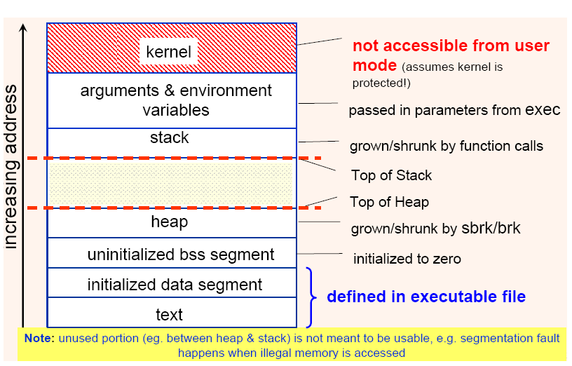
How an OS Works
Memory Management

Slide 22
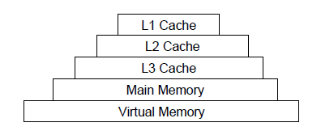
How an OS Works
Virtual Memory Management
For cost/speed reasons memory is organized in a hierarchy:
The lowest level is called “virtual memory” and is the slowest but cheapest memory.
  Actually made using hard-disk space!
  Allows us to fit much more instructions and data than memory allows!

Slide 23
How an OS Works
Securing Data

Slide 24
How an OS Works
Security
Here security means controlling access to various resources.
  Data (files)
    Encryption techniques
    Access control lists
  Resources
    Access to the hardware (biometric, passwords, etc)
    Memory access
    File access
    Etc.

Slide 25
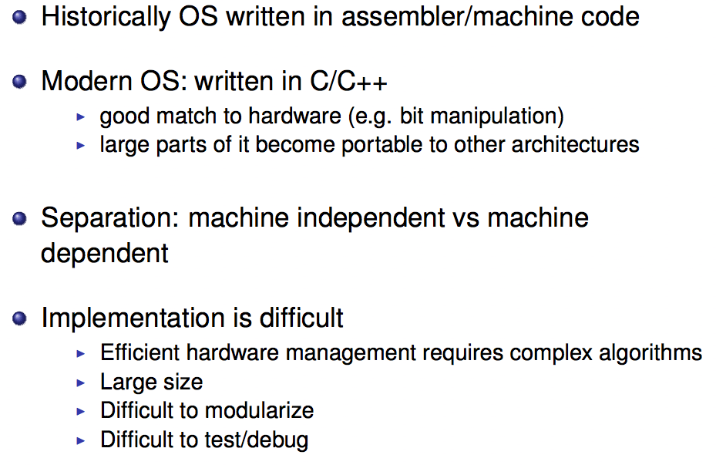
Writing an OS

Slide 26
Writing an OS
ARDOS (http://www.bitbucket.org/ctank/ardos-ide)
  Very small operating system built for Arduino
  Only context switching and hardware setup code is machine dependent.
    Context switching code in assembly.
    Hardware setup code in C but manipulates hardware registers specific to the ATmega328P.
  Task management, communication code etc. is completely portable.

Slide 27
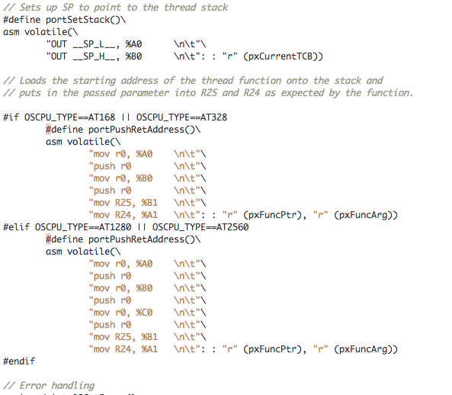
Writing an OS

Slide 28
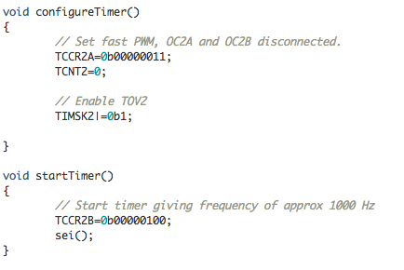
Writing an OS

Slide 29
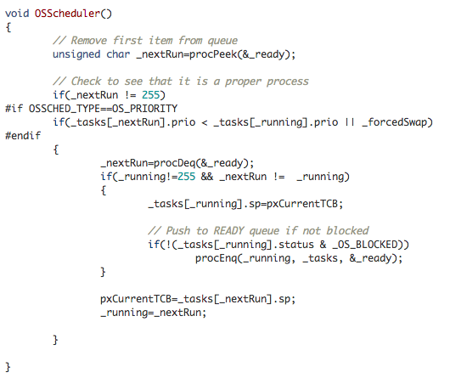
Writing an OS

Slide 30
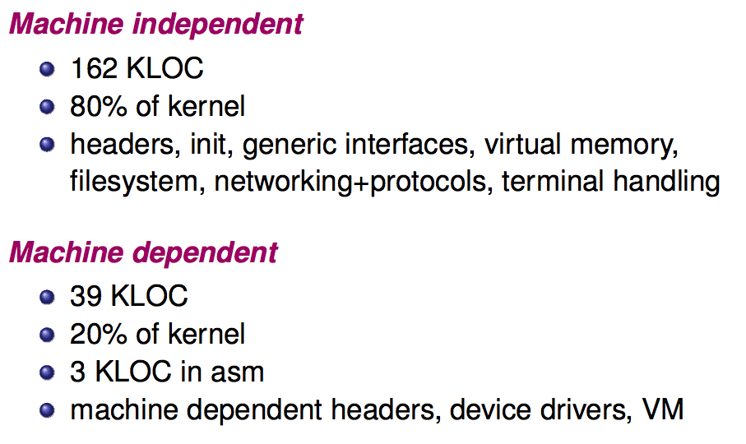
Writing an OS (BSD Unix)

Slide 31
Monolithic Kernels
Kernels can be monolithic or microkernel.
Monolithic kernels:
  All major parts of the OS – devices drivers, file systems, IPC, etc, running in “kernel space”.
    “Kernel space” generally means an elevated execution mode where certain privileged operations are allowed.
  Bits and pieces of the kernel can be loaded and unloaded at runtime (e.g. using “modprobe” in Linux)
  Popular examples of monolithic kernels: Linux, MS Windows.

Slide 32
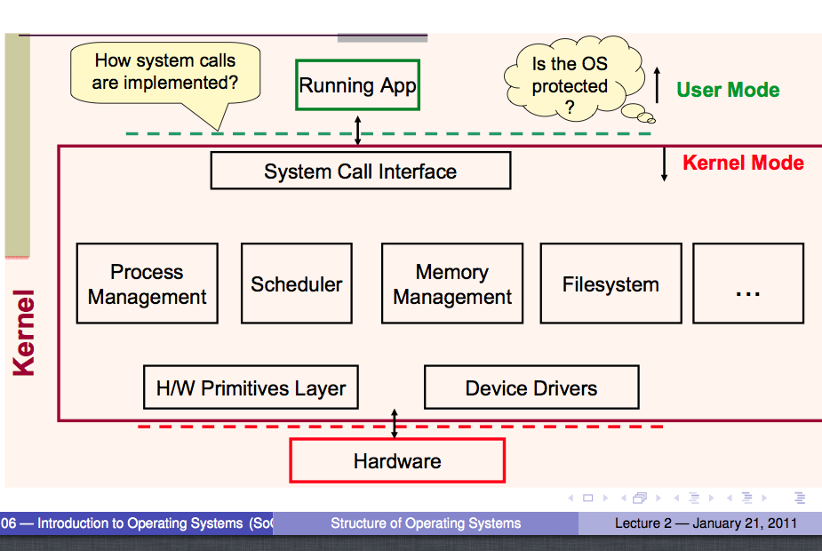
Monolithic Kernels

Slide 33
Microkernels
In modular kernels:
  Only the “main” part of the kernel is in “kernel space”:
Contains the important stuff like the scheduler, process management, memory management, etc.
  The other parts of the kernel operate in “user space” as system services:
    The file systems.
    USB device drivers.
    Other device drivers.
Most famous microkernel OS: MacOS.

Slide 34
External View of an OS
The kernel itself is not very useful.
  Provides key functionality, but need a way to access all this functionality.
We need other components:
  System libraries (e.g. stdio, unistd, etc.)
  System services (creat, read, write, ioctl, sbrk, etc.)
  OS Configuration (task manager, setup, etc.)
  System programs (Xcode, vim, etc.)
  Shells (bash, X-Win, Windows GUI, etc.)
  Admin tools (User management, disk optimization, etc.)
  User applications (Word, Chrome, etc).

Slide 35
System Calls
System calls are calls made to the “Application Program Interface” or API of the OS.
  UNIX and similar OS mostly follow the POSIX standard.
    Based on C.
    Programs become more portable.
  Windows follows the WinAPI standard.
    Windows 7 and earlier provide Win32/Win64, based on C.
    Windows 8 provide Win32/Win64 (based on C) and WinRT (based on C++).

Slide 36
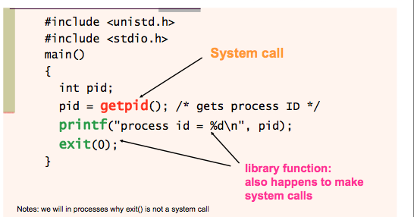
System Calls

Slide 37
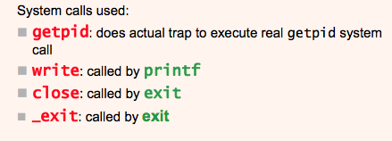
System Calls

Slide 38
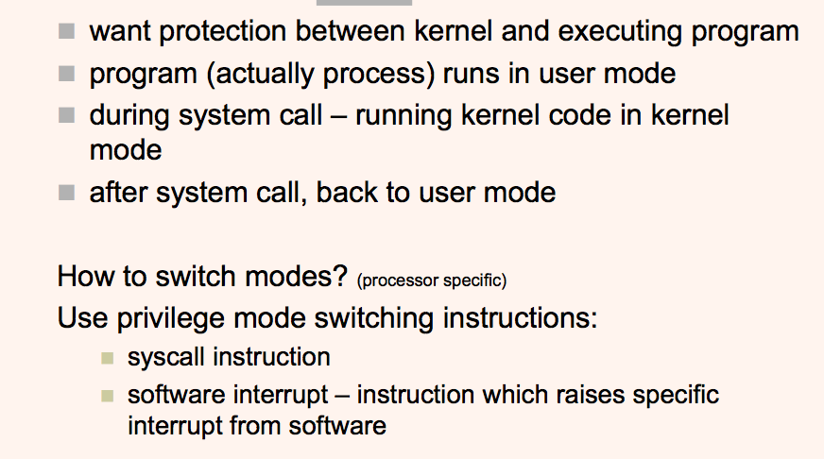
User Mode + Kernel Mode

Slide 39
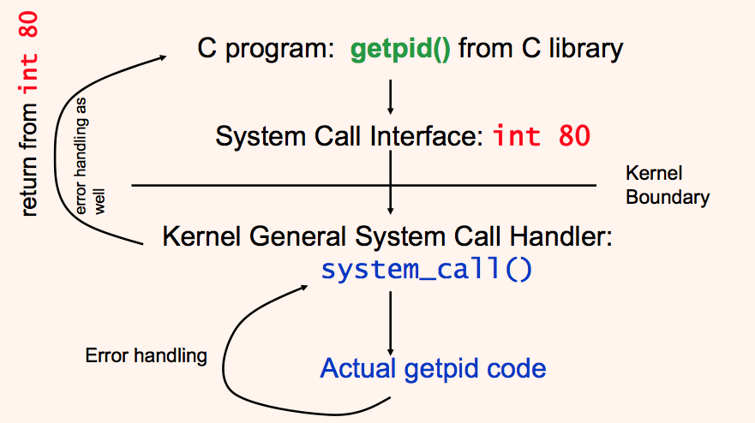
System Calls in LINUX

Slide 40
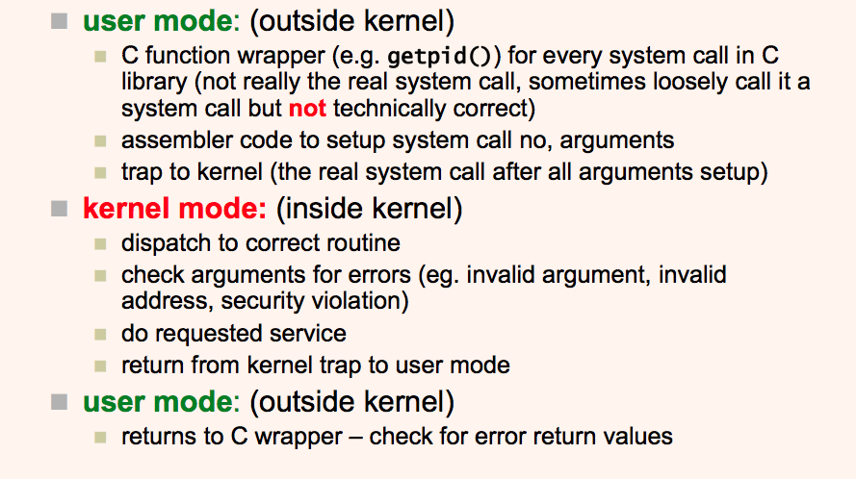
LINUX System Call

Slide 41
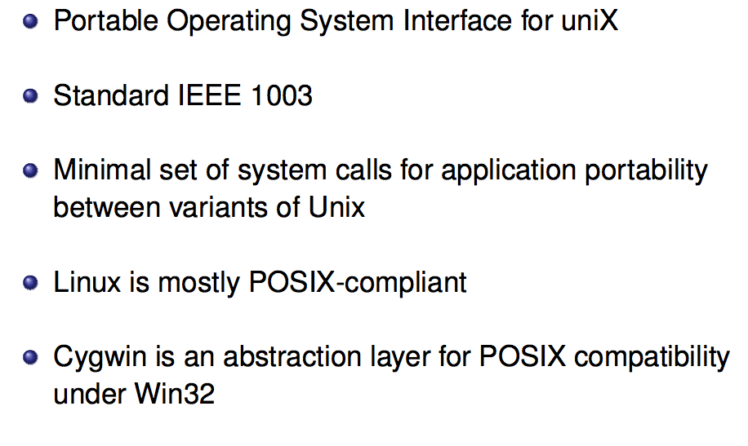
POSIX

